Slide 1
Lecture 2.2 – Computing with Numbers
M30299 Programming
School of Computing University of Portsmouth

Slide 2
Introduction to lecture
In the previous lecture we:
introduced the concept of a data type; and
covered the basics of Python’s numeric data types, int and float.
In this lecture, we will:
review some of the ideas from that lecture.
cover the remaining important details of the numeric types.
We will cover the use of some more advanced data types in the following few lectures.

Slide 3
Review of Python’s data types (1)
Recall Python’s int, float and str data types:
>>> type(3) <class 'int'> >>> type(-42) <class 'int'> >>> type(3.14) <class 'float'> >>> type("Hello") <class 'str'> >>> type(3 + 4.2) <class 'float'>

Slide 4
Review of Python’s data types (2)
Consider the following version of our weight conversion program:
kilos_input = input("Enter a weight in kilos: ") kilos = int(kilos_input) pounds = 2.2 * kilos print("The weight in pounds is", pounds)
If the user enters 10 at the prompt, what will be the values and types of the following variables at the end of the program?
kilos_input
kilos
pounds

Slide 5
Obtaining user input …revisited
What do you think will happen if we execute the following code and the user enters 10?
kilos = input("Enter a weight in kilos: ") pounds = 2.2 * kilos
What about the following code if the user enters their name?
name = int(input("Enter your name: ")) print("Hello,", name)

Slide 6
Arithmetic involving ints and floats
We saw last lecture that the int and float data types include the arithmetic operators +, -, *, / and ** (power).
Each of these operators takes two operands. Usually:
if both operands are ints (e.g. 3 + 4), the result is an int (here, 7).
if both are floats (e.g. 3.1 + 4.2), the result is an float (7.3).
If the operands are of different types, e.g.:
3 + 4.2
then the integer (3) is automatically converted into a float (3.0), and then a floating-point operation is performed (to give 7.2).

Slide 7
Floating point and integer division
There is one exception to the above – the division operator / always performs floating point division:
>>> 11 / 4 2.75
There is a separate integer division operator //:
>>> 11 // 4 2
(When given two int operands, this gives an int result.)

Slide 8
Integer division and remainder
Finally, the operator % that gives the remainder of an integer division:
>>> 11 % 4 3
Integer division and remainder can often be useful; e.g.:
>>> children = 3 >>> sweets = 14 >>> sweets_each = sweets // children >>> sweets_left_for_me = sweets % children
What are the values of sweets_each and sweets_left_for_me?

Slide 9
Dangers of floating-point arithmetic (1)
Recall that we’ve said that float values are represented by the computer during a fixed amount of space (64 binary digits).
This limits the accuracy at which some real-world values can be represented and sometimes leads to some surprising issues.
To see this, let’s first pretend that computers worked with decimal (base 10) numbers instead of binary (base 2).
Assume that we have to represent values in decimal using at most 5 figures.
The number 1/3 would be represented as 0.3333; this is clearly an approximation to its true value.
We know, for example, that 1/3 × 3 is equal to 1, but 0.3333 × 3 gives a different value, 0.9999.

Slide 10
Dangers of floating-point arithmetic (2)
Further, some numbers such as 0.1 can be represented accurately using a limited number of digits in decimal, but they cannot in binary. Try:
>>> x = 0 >>> x = x + 0.1 (repeat this statement ten times) >>> x 0.9999999999999999
We expected the final result to be 1, but it isn’t!.
These problems are true of all programming languages that use floating point numbers — Python, C, Java …
(This sometimes needs to be kept in mind when using float — e.g. when testing whether two numbers are equal.)

Slide 11
Built-in numeric functions (1)
There are a few other built-in functions that we may find useful:
The round function rounds a float to the nearest int:
>>> round(3.8) 4 >>> round(6.2) 6
round can also restrict the number of digits after the decimal point in a float:
>>> round(1.237143225, 2) 1.24
>>> round(5.0, 2)
5.0 # make sure you understand why 5.00 wasn’t given here!

Slide 12
Built-in numeric functions
The abs function returns the absolute (i.e. positive) value of a number:
>>> abs(-3) 3 >>> abs(3) 3
The pow function does the same thing as **:
>>> pow(2, 3) 8 >>> pow(2, 0.5) 1.4142135623730951

Slide 13
Using the math module (1)
Other mathematical functions are not built-in to the language, but are defined in a module called the math module.
A module is often just another Python file. (Large programs are usually split into several separate modules.)
There are many Python modules available for doing graphics, internet programming, connecting to databases, etc.
To use a module, we first have to import it:
>>> import math

Slide 14
Using the math module (2)
Among the things the math module provides are constants; a constant in Python is simply a variable whose value should not be changed.
To use a constant or function defined in another module, we need to prefix its name with the module’s name and a dot; e.g.
>>> math.pi 3.1415926535897931
Functions in the math module include one for finding square roots:
>>> math.sqrt(2) 1.4142135623730951

Slide 15
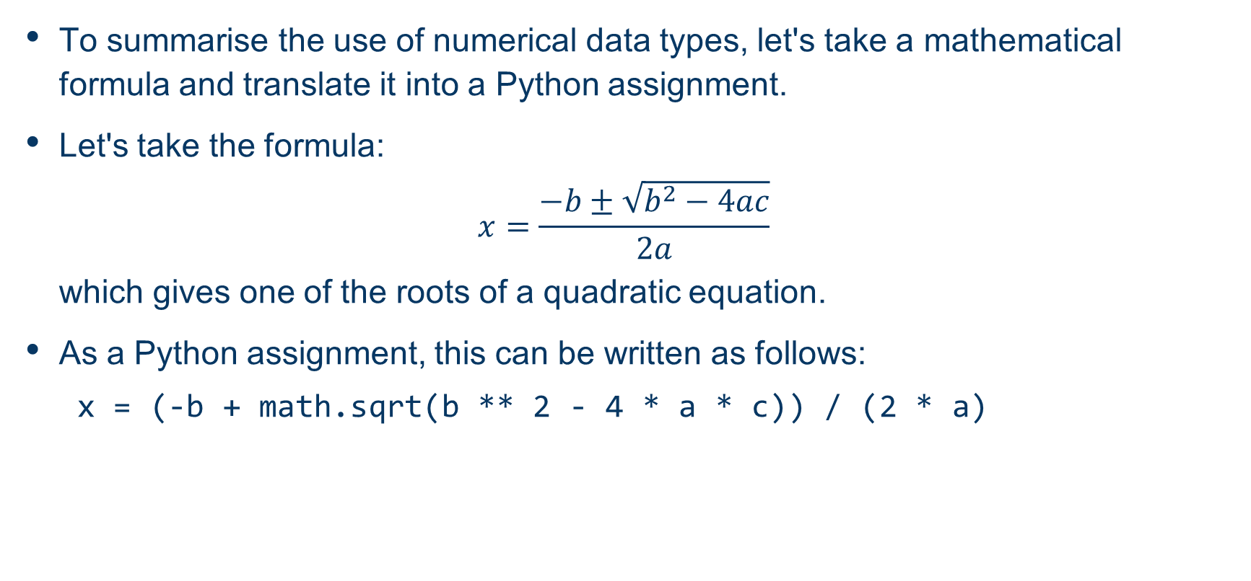
Translation of mathematical formulae

